Slide 1
IBM University Engagement Project Submission
“Exploring the Power of Agentic AI with IBM Granite and IBM Bob”

Slide 2

Project Tile – COURSE CONTENT SIMPLIFICATION AGENT
Domain of Project – Education
Student Name | Recent Passport Photo | Email ID | Mobile number [WhatsApp]
Mohamed Rifath |  | mdrifath932@gmail.com | 9360458861
AICTE Student Id - STU6a69e81ac4abc1785325594
College - Pondicherry University

Slide 3
PROBLEM STATEMENT
Problem Statement No. 19 — Course Content Simplification Agent
The Challenge :
Educational materials often contain complex language and technical terminology.
Students have different levels of prior knowledge and learning ability.
Difficult explanations can make important academic concepts hard to understand.
Traditional content is often presented at a single difficulty level.
Learners may need the same concept explained in different ways and levels of detail.
There is a need for an AI system that can analyze and simplify academic content intelligently.
The solution should support learning by adapting explanations from beginner to expert level.

Slide 4
PROJECT DESCRIPTION
Analyse Academic Content – Process complex notes, paragraphs and study material.
Simplify Complex Concepts – Convert difficult content into clear and understandable explanations.
Adapt to Learner Level – Generate content suitable for beginner, intermediate and expert learners.
Preserve Core Meaning – Simplify language without losing important technical information.
Improve Learning Accessibility – Make academic content easier to understand for diverse learners.
Support Personalized Learning – Provide explanations according to the learner's knowledge level.
Enhance Study Efficiency – Help students understand important concepts faster and more effectively.

Slide 5
OBJECTIVES
Content Understanding – Analyse academic material and identify the key concepts.
Content Simplification – Transform complex explanations into simpler and clearer language.
Level-Based Learning – Generate beginner, intermediate and expert-level explanations.
Meaning Preservation – Maintain the original concept while reducing unnecessary complexity.
Personalized Education – Adapt explanations to different learner requirements.
AI-Powered Assistance – Use IBM Granite to generate intelligent and context-aware responses.
Learning Support – Improve accessibility, comprehension and independent learning.

Slide 6
PROPOSED SOLUTION
Proposed Solution: AI-Powered Course Content Simplification Agent
Intelligent Content Processing – Accepts academic content as user input.
IBM Granite Intelligence – Uses Granite for natural-language understanding and content generation.
Learner-Level Adaptation – Produces explanations based on beginner, intermediate or expert level.
Concept Extraction – Identifies the main ideas and important technical terms.
Simplified Explanation – Rewrites complex academic content into clear language.
Structured Learning Output – Can provide explanations, key points, examples and summaries.
IBM Bob Orchestration – IBM Bob is used to develop and organize the agent workflow.

Slide 7
TECHNOLOGY USED
• IBM Bob Platform – Used for developing the application, integrating the AI workflow, refining code, and testing the solution.
• IBM Granite-4.0-H-Small – Used for natural language understanding, reasoning, academic content simplification, and generating learner-level explanations.
• IBM Cloud – Provides the cloud infrastructure and services required to connect, run, and deploy the AI application.
• IBM Cloud IAM – Used for secure authentication and access-token generation for IBM AI service integration.
• IBM watsonx.ai – Used to access and run the IBM Granite model for AI-powered academic content processing and generation.
• Python / Flask – Used to develop the backend, handle user requests, connect with IBM services, and return the generated learning content.

Slide 8
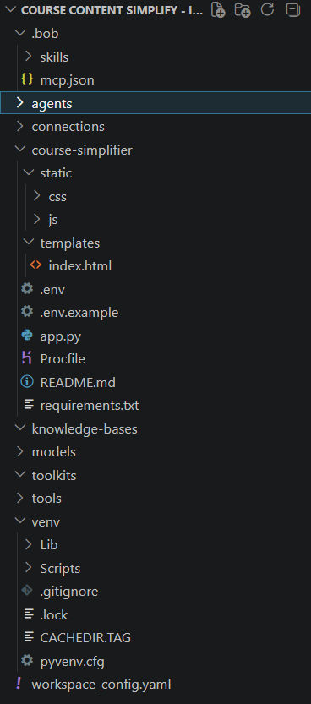
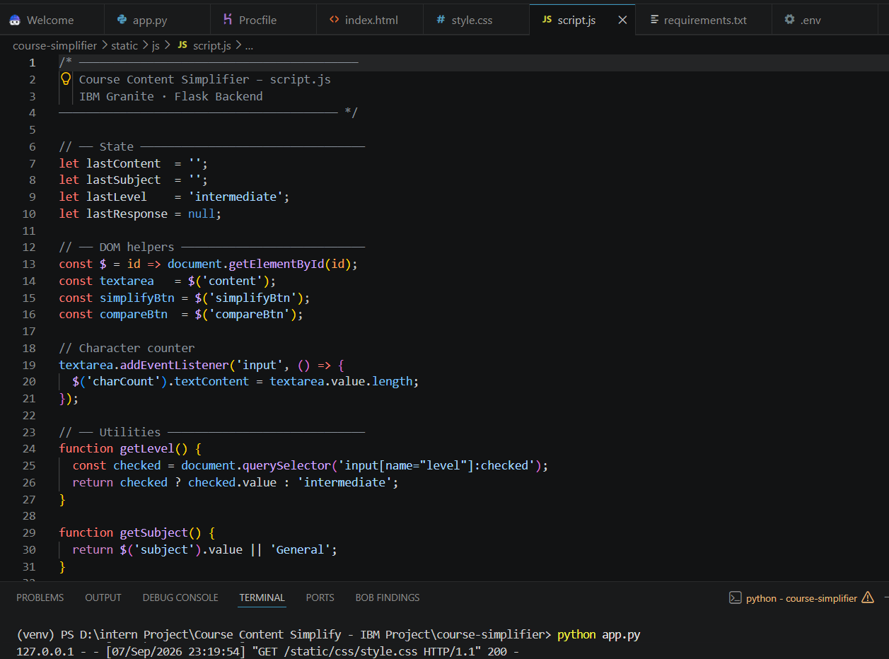
Files created using IBM BoB

Slide 9
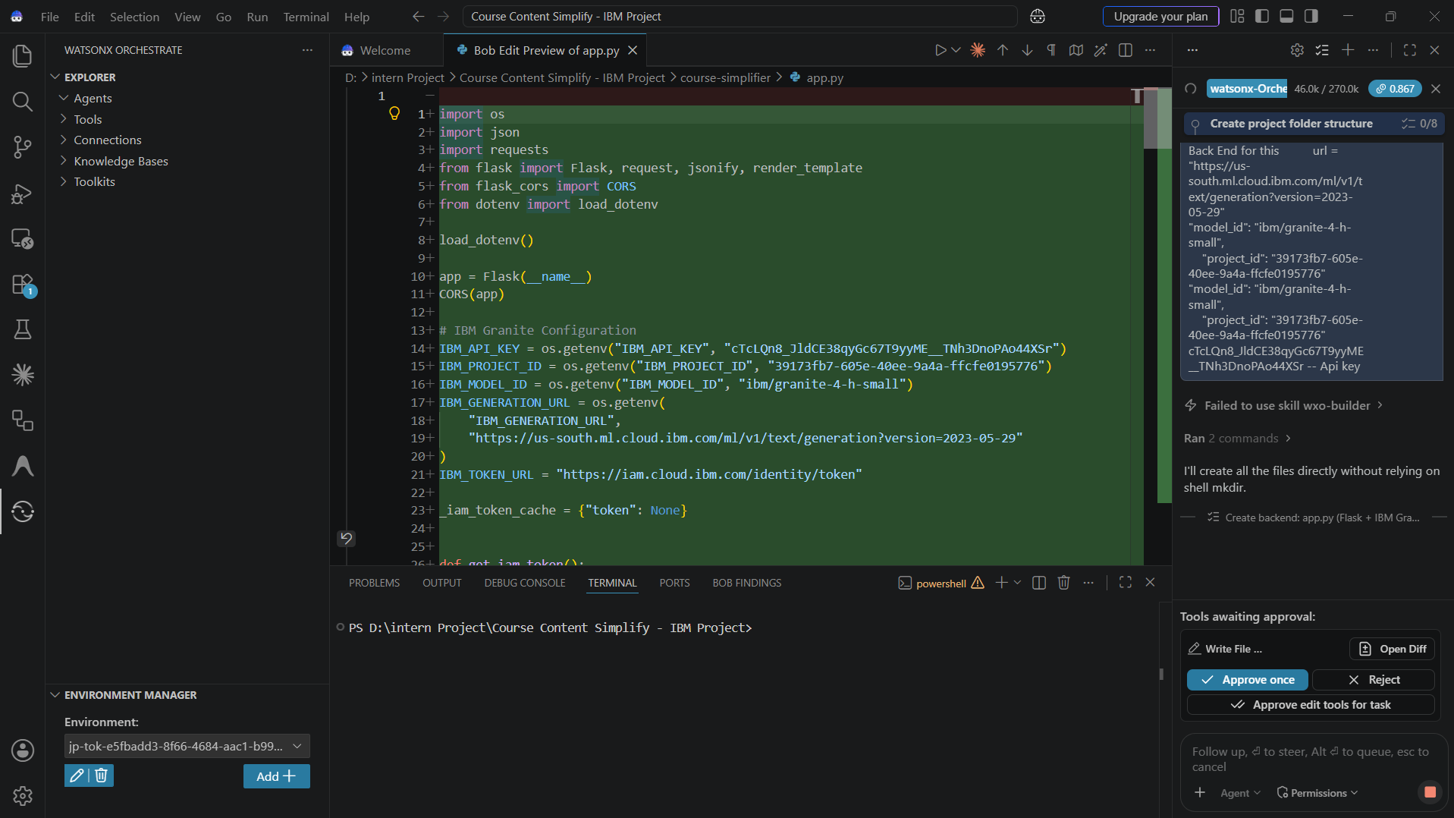
IBM Bob Screenshots

Slide 10
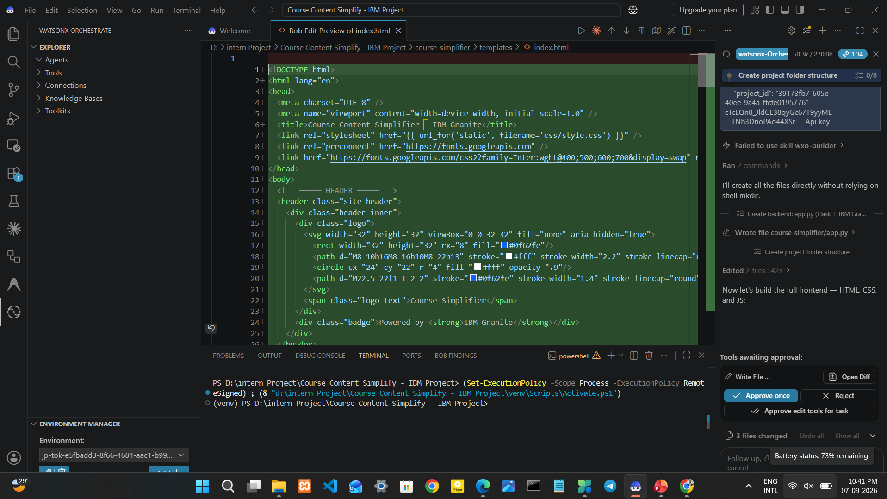
IBM Bob Screenshots

Slide 11
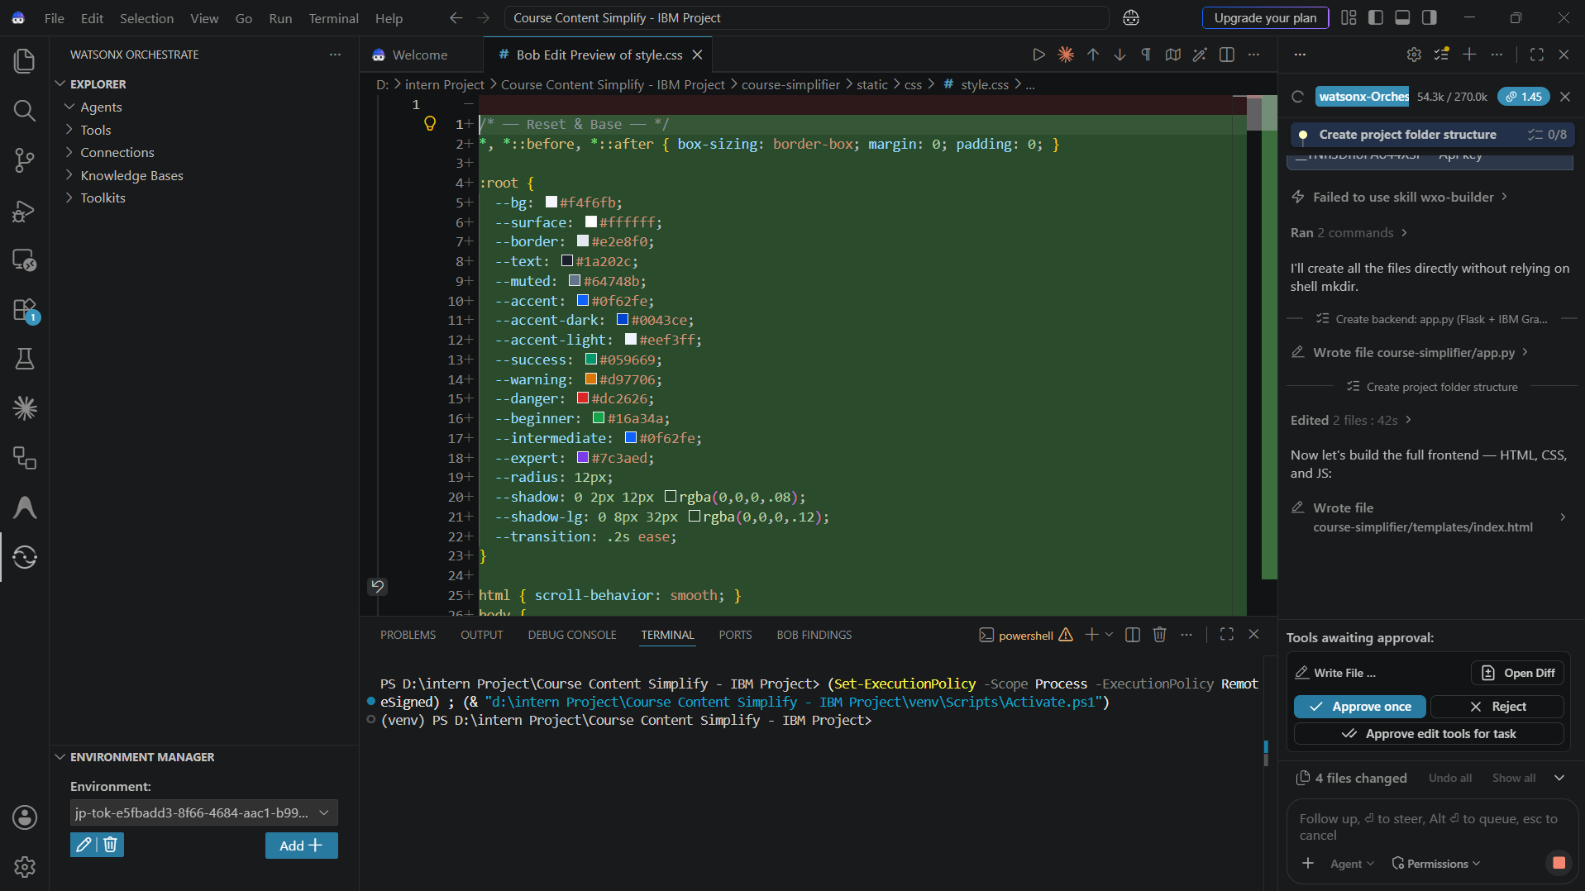
IBM Bob Screenshots

Slide 12
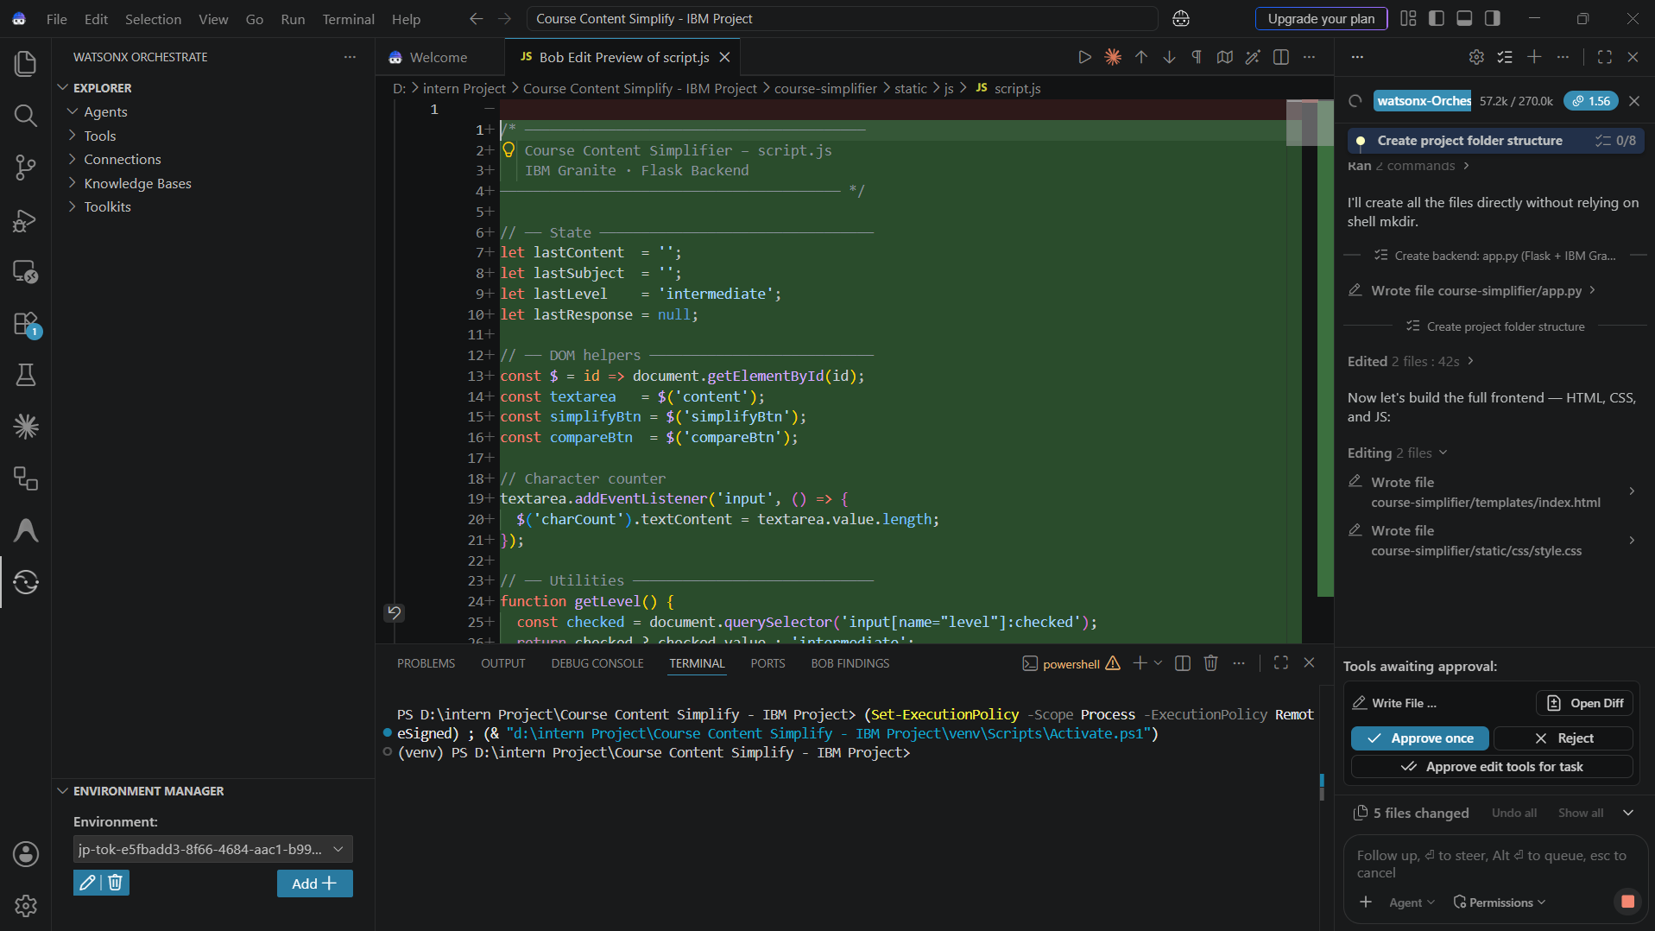
IBM Bob Screenshots

Slide 13
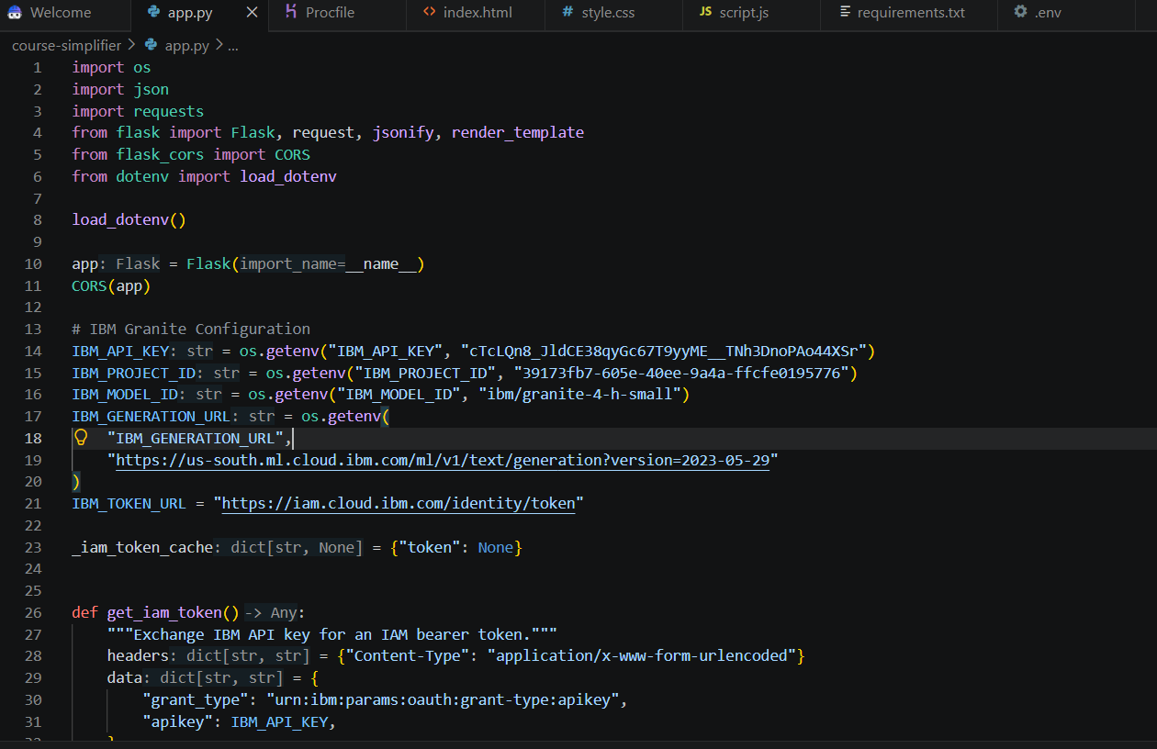
IBM Bob Screenshots

Slide 14
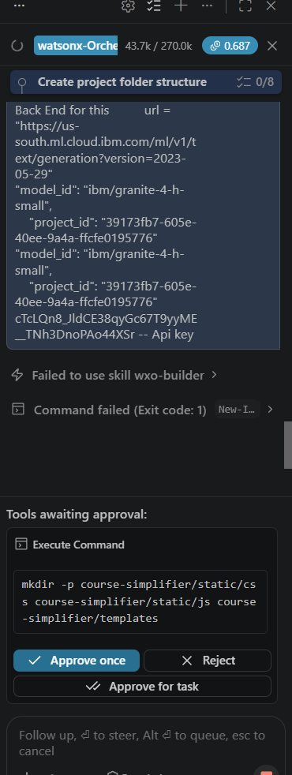
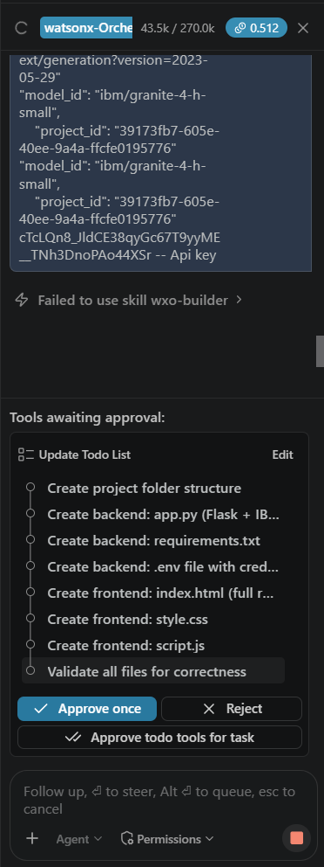
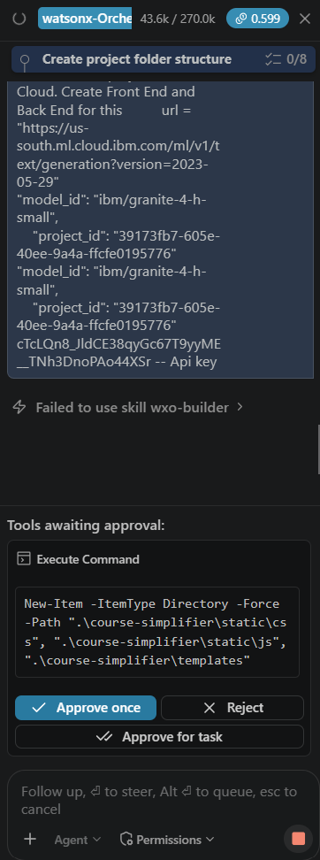
IBM Bob Screenshots

Slide 15
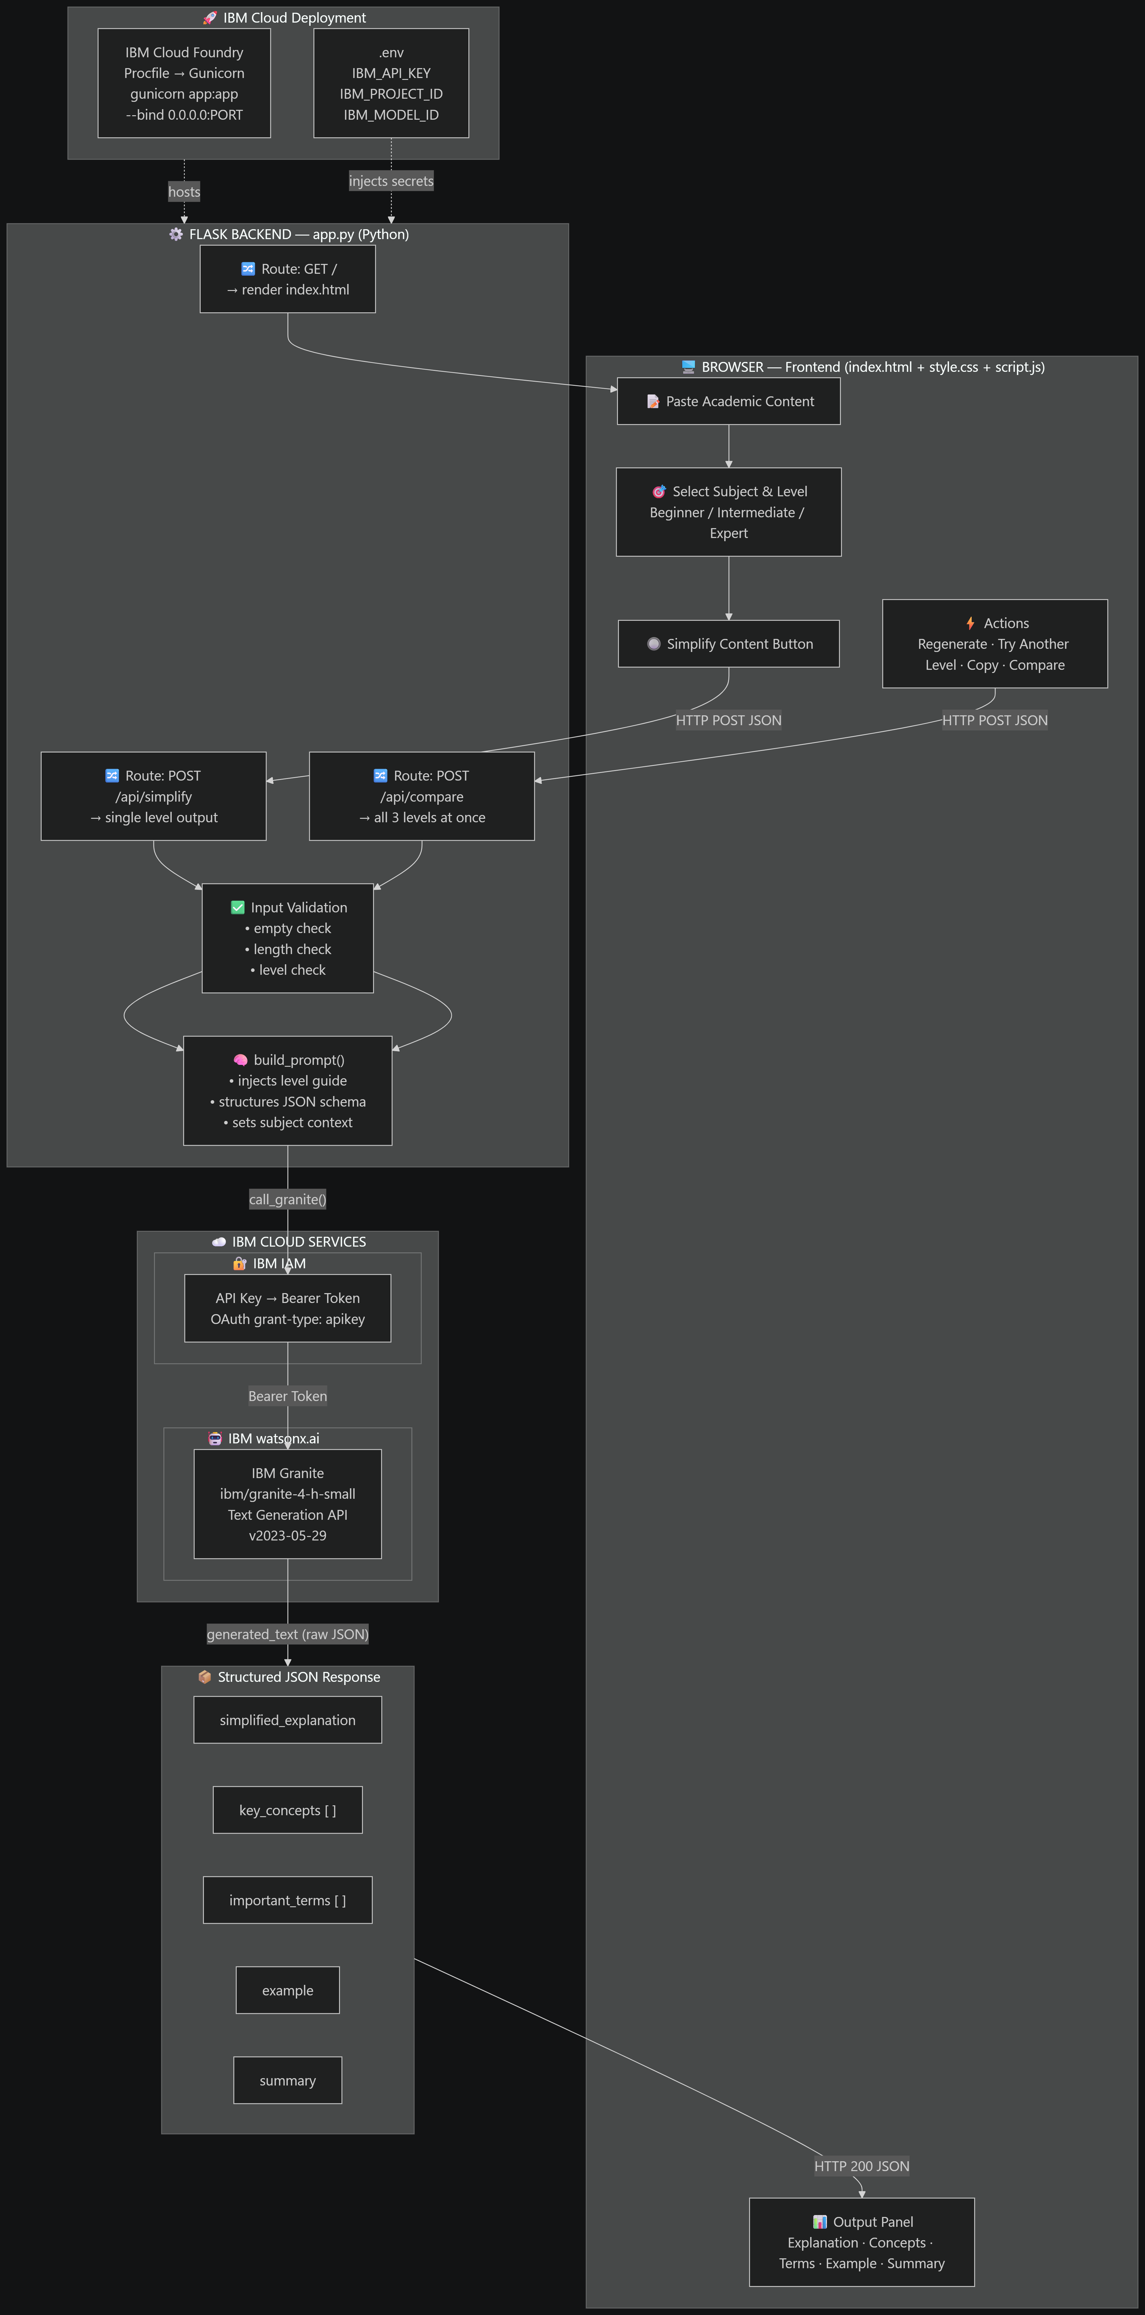
Architecture blueprint for IBM bob:

Slide 16

Role of Agentic AI in the Solution
IBM Granite – AI Engine: Analyses academic content and generates simplified, level-based explanations.
Learner-Level Adaptation: Adjusts language, technical depth and explanation style for Beginner, Intermediate and Expert users.
Content Understanding: Identifies key concepts, important terms and the main meaning of the provided academic content.
Structured Generation: Produces explanations, key concepts, examples and summaries in a clear format.
IBM Cloud Services: Provides secure authentication, AI model access and cloud infrastructure for Granite integration.
IBM Bob – Development Support: Assists in building the frontend, backend, prompts, Granite integration and application workflow.
End-to-End AI Workflow: Combines IBM Bob, IBM Cloud and IBM Granite to transform complex academic content into personalized learning material.

Slide 17
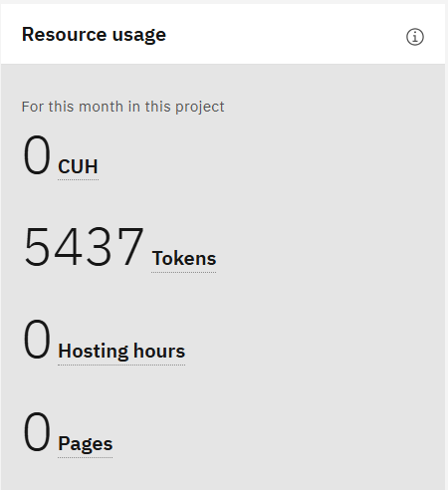
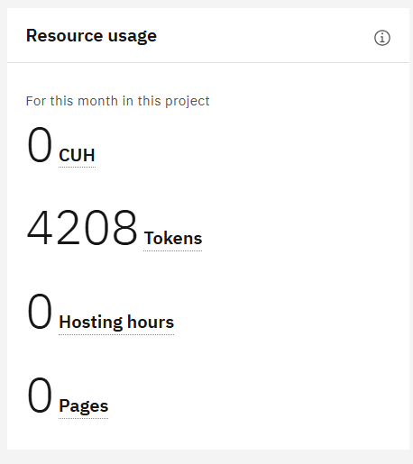
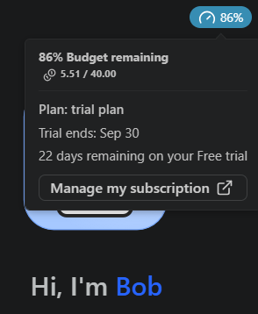
Token Usage
1,229 tokens are used in a single prompt
Before Prompt
After the Prompt
IBM BOB Token Usage
·
·
·

Slide 18
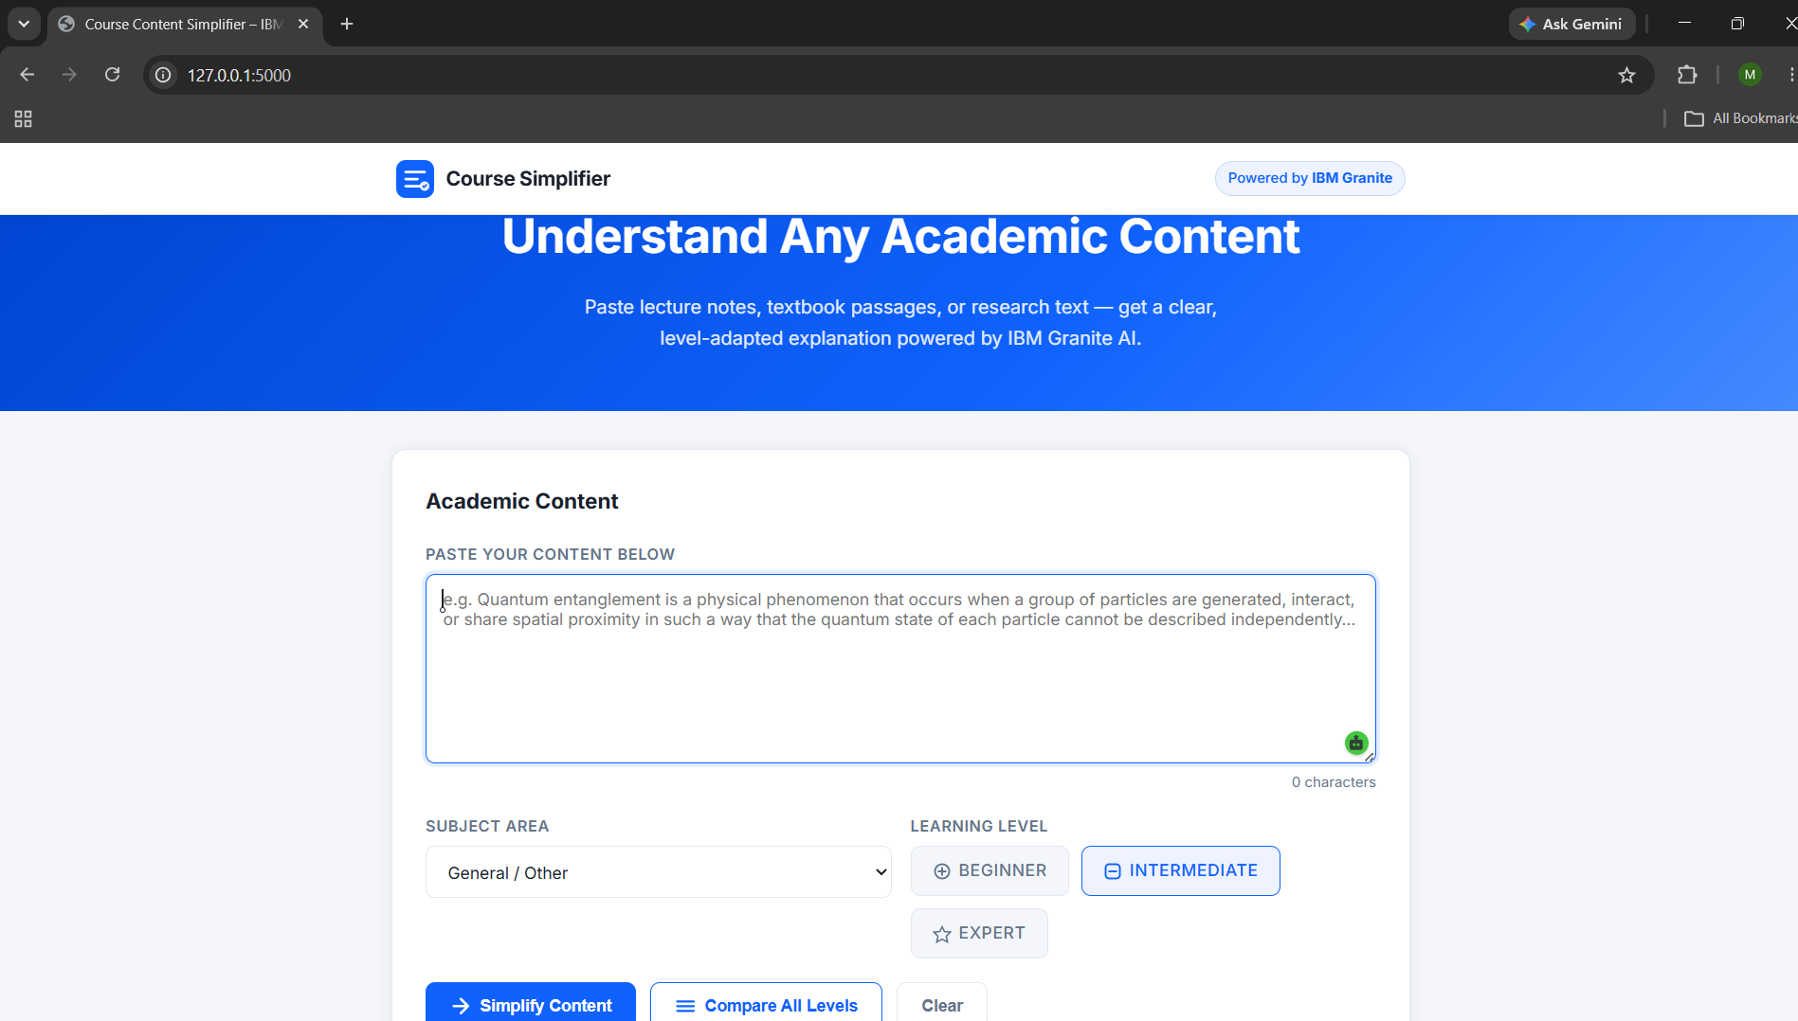
Project Output Screenshot

Slide 19
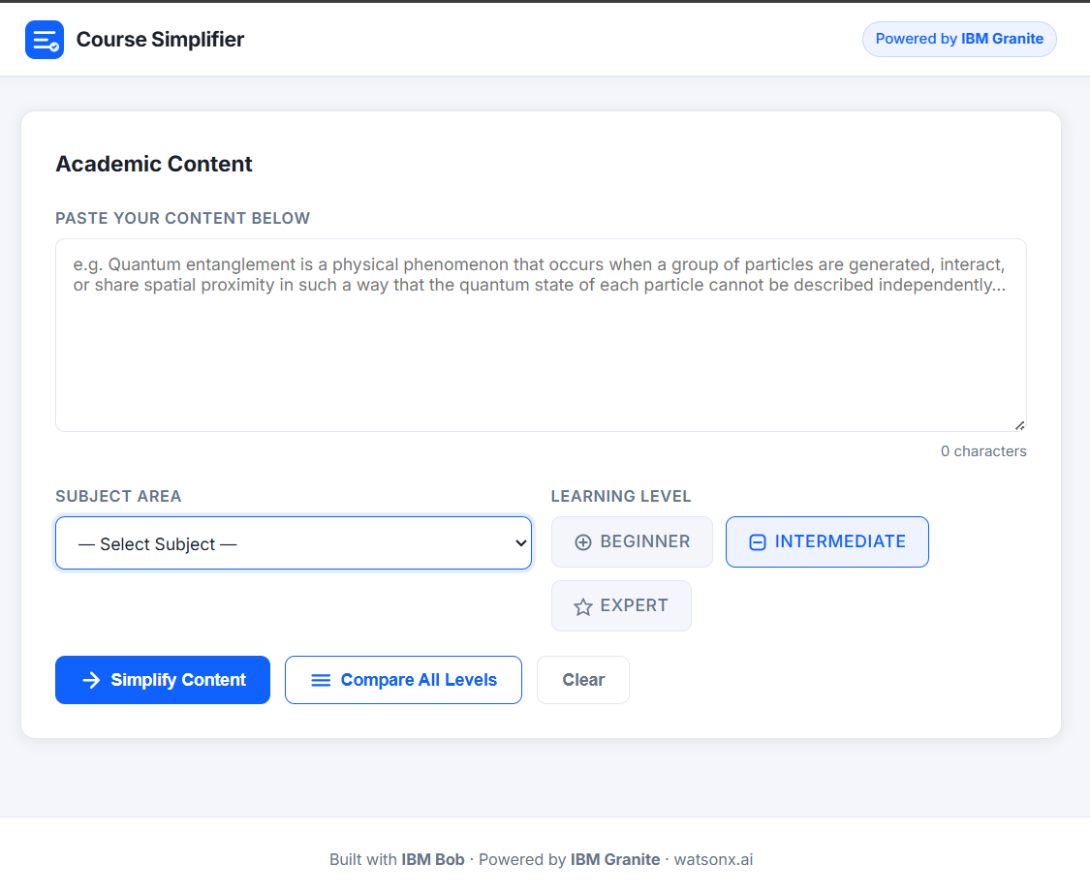
Project Output Screenshot

Slide 20
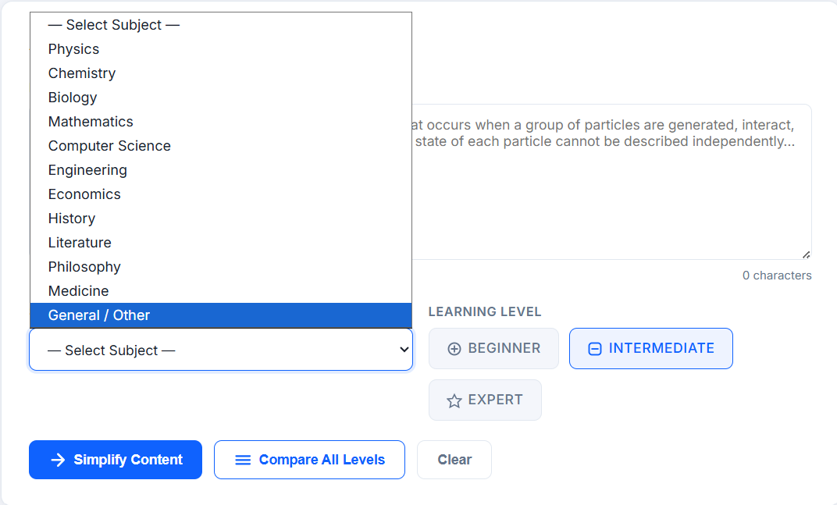
Project Output Screenshot

Slide 21
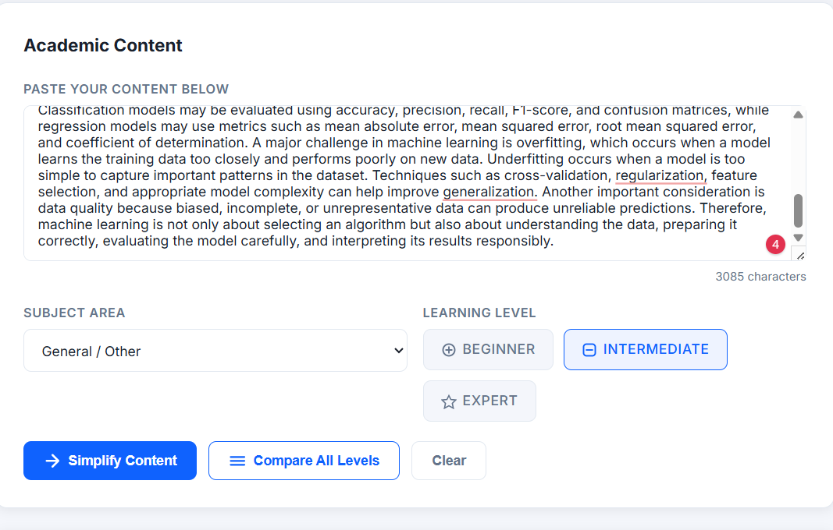
Project Output Screenshot

Slide 22
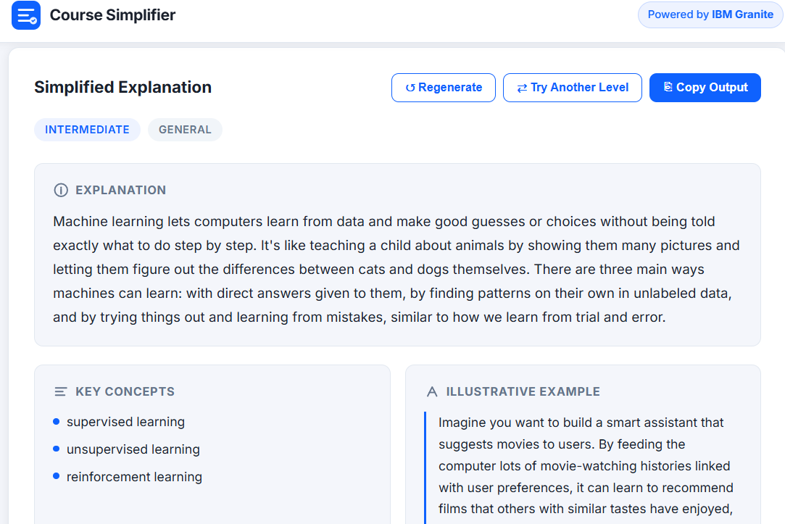
Project Output Screenshot

Slide 23
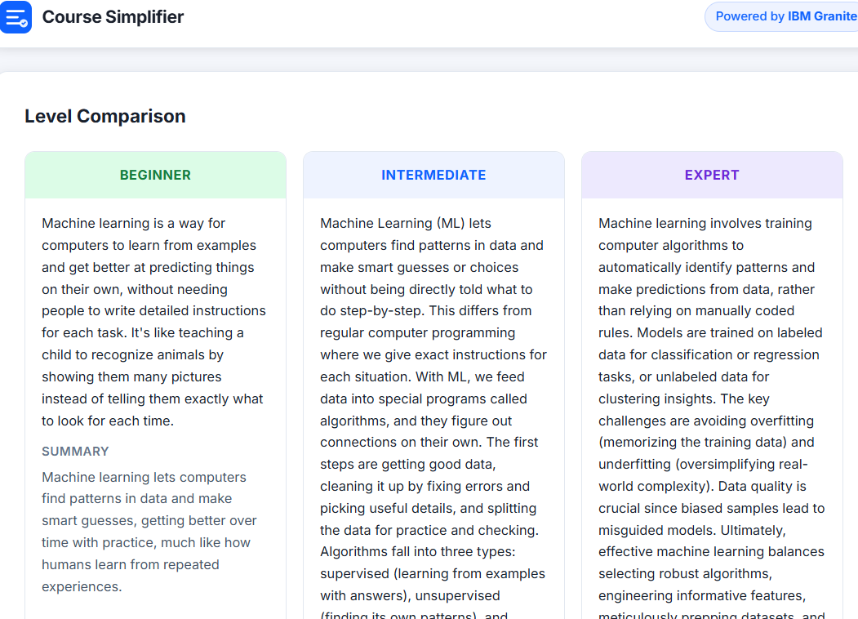
Project Output Screenshot

Slide 24
Novelty and Uniqueness
Adaptive Learning Intelligence – Converts the same academic content into Beginner, Intermediate and Expert explanations.
Learner-Centric Simplification – Adjusts vocabulary, technical depth and explanation style according to the learner’s proficiency.
IBM Granite-Powered Generation – Uses IBM Granite to understand academic content and generate context-aware, structured learning material.
IBM Cloud Integration – Uses IBM Cloud services for secure authentication, Granite model access and reliable cloud-based AI processing.
IBM Bob-Assisted Development – Uses IBM Bob to build, integrate, test and refine the application and its AI workflow.
Meaning-Preserving Transformation – Simplifies complex material while retaining essential concepts, terminology and academic meaning.
Interactive Learning Experience – Allows users to regenerate content, switch learning levels and compare different explanations from the same source.

Slide 25
Future Scope
Multilingual Learning – Extend the agent to simplify and explain academic content in regional and international languages.
PDF & Document Support – Enable direct processing of textbooks, lecture notes, presentations and academic PDFs.
Voice-Based Learning – Add voice input and audio explanations for more accessible learning.
Personalized Learning Paths – Adapt explanations based on learner progress, preferences and previous interactions.
Interactive Quiz Generation – Automatically create quizzes, questions and practice exercises from simplified content.
IBM AI Service Expansion – Integrate additional IBM Cloud and AI services to improve scalability, reliability and educational capabilities.
Smart Learning Analytics – Analyze learning interactions to identify difficult topics and provide targeted support.

Slide 26
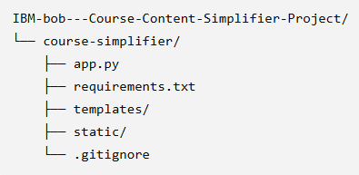
Git Hub Link
GitHub Repository Link - https://github.com/Rifacspu2004/IBM-bob---Course-Content-Simplifier-Project-.-
Repository File Structure
Use ctrl + click for link

Slide 27
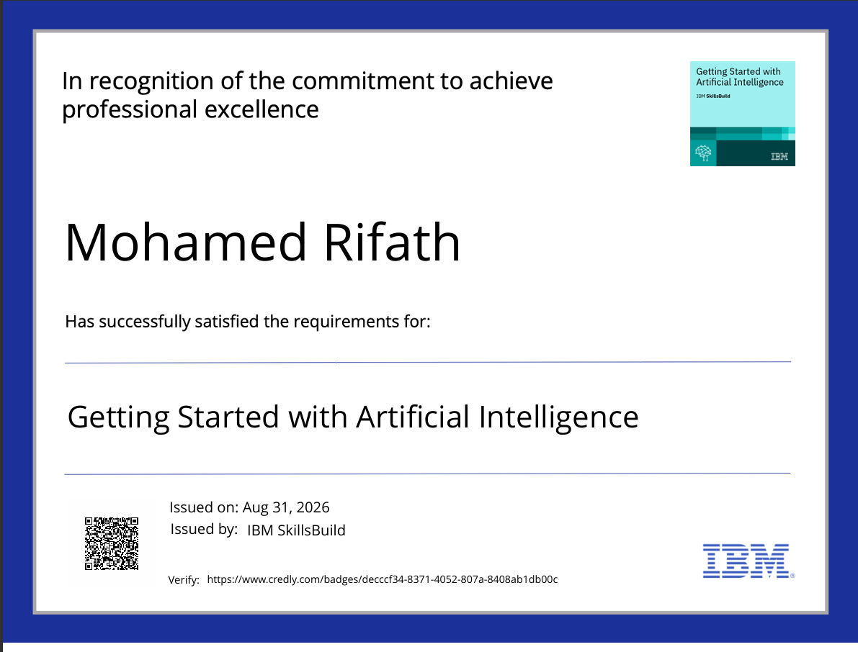
Certificates Earned:
(Getting Started with Artificial Intelligence)

Slide 28
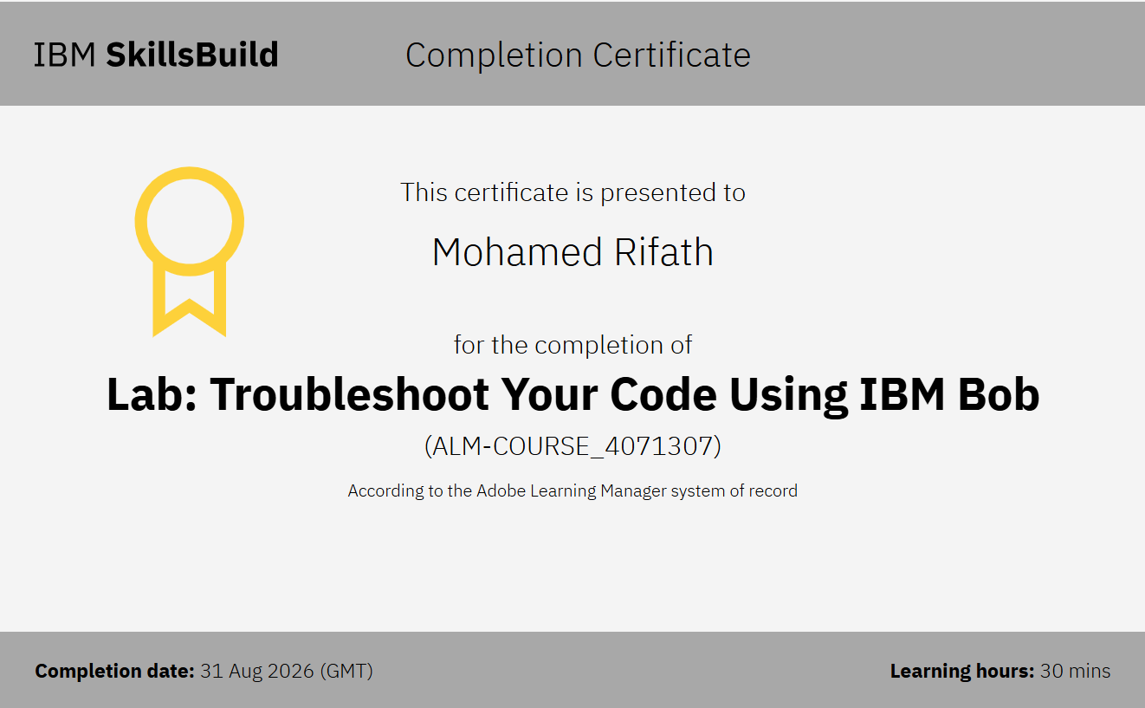
Certificates Earned:
2. (IBM BOB Certificate)

Slide 29


